Slide 1
Microprocessor Architecture ECE4375 / 5375
Dr. Argenis Bilbao
Spring 2026

Slide 2
Presentation Outline
Word / Byte addressing
Register operations
Registers and names
Immediate operations
Logical operations
Shift operations

Slide 3
RISC V Architecture: Operands
Operand location: Physical location in computer.
Registers
Memory
Constants (also called immediates)

Slide 4
RISC V Architecture: Registers
RISC V has 32 32-bit registers.
Registers are faster than memory.
RISC V called “32-bit architecture” because it operates on 32-bit data.

Slide 5
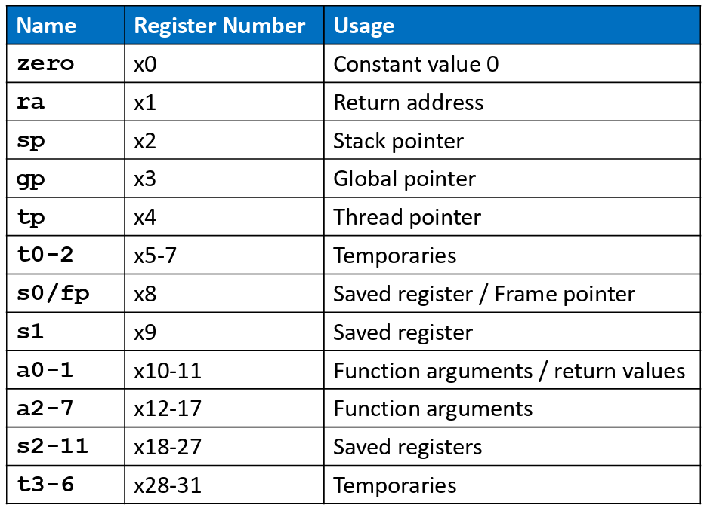
RISC V Architecture: CPU Registers

Slide 6
RISC V Architecture: Registers
Registers:
  Can use either name (i.e., ra, zero) or x0, x1, etc.
  Using name is preferred.
Registers used for specific purposes:
  zero always holds the constant value 0.
  The saved registers, s0-s11, used to hold variables.
  The temporary registers, t0-t6, used to hold intermediate values during a larger computation.
  Will discuss others later.

Slide 7
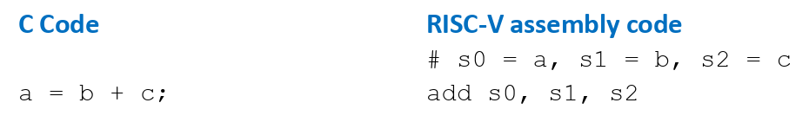
RISC V Architecture: Instructions with Registers
The add instruction.

Slide 8
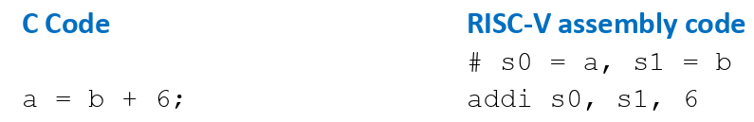
RISC V Architecture: Instructions with Constants
The addi instruction.

Slide 9
RISC V Architecture: Memory Ops
Too much data to fit in only 32 registers.
Store more data in memory.
Memory is large, but slow.
Commonly used variables kept in registers.

Slide 10
RISC V Architecture: Memory Ops
First, we’ll discuss word-addressable memory.
Then we’ll discuss byte-addressable memory.
RISC V is Byte-addressable!

Slide 11
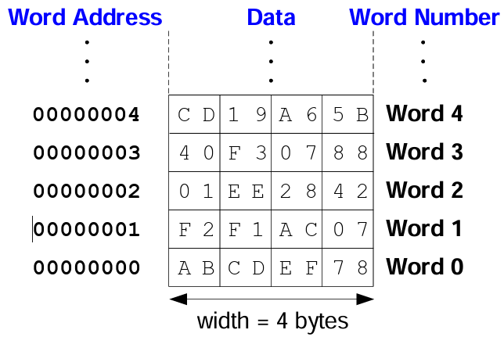
RISC V Architecture: Memory Ops (Word)
Each 32-bit data word has a unique address.

Slide 12
RISC V Architecture: Memory Ops (Word)
Memory read called load.
Mnemonic: load word (lw)
Format:
  lw t1, 5(s0)
  lw destination, offset(base)
Address calculation:
  Add base address (s0) to the offset (5)
  Address = (s0 + 5)
Result:
  t1 holds the data value at address (s0 + 5)
ANY REGISTER can be used as base address!

Slide 13
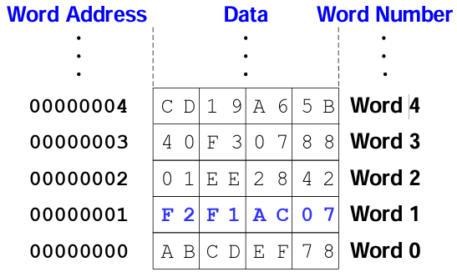
RISC V Architecture: Memory Ops (Word)
Example: Read a word of data at memory address 1 into s3
  Address = (0 + 1) = 1
  s3 = 0xF2F1AC07 after load
Assembly code:
lw s3, 1(zero) # read memory word 1 into s3

Slide 14
RISC V Architecture: Memory Ops (Word)
Memory write is called a store.
Mnemonic: store word (sw).

Slide 15
RISC V Architecture: Memory Ops (Byte)
The address of a memory word must now be multiplied by 4. For example:
  The address of memory word 2 is 2 × 4 = 8
  The address of memory word 10 is 10 × 4 = 40 (0x28)
RISC-V is byte-addressed, not word addressed.

Slide 16
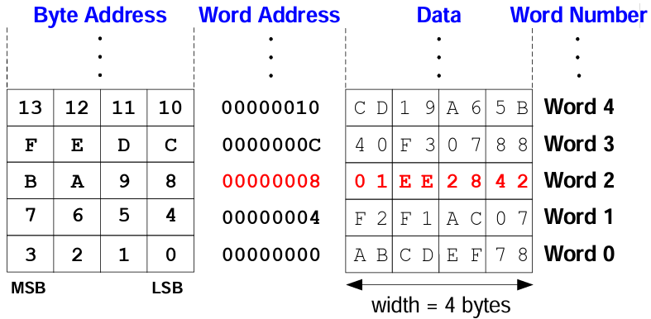
RISC V Architecture: Memory Ops (Byte)
Example: Load a word of data at memory address 8 into s3.
s3 holds the value 0x1EE2842 after load
RISC V assembly code:
lw s3, 8(zero) # read word at address 8 into s3

Slide 17
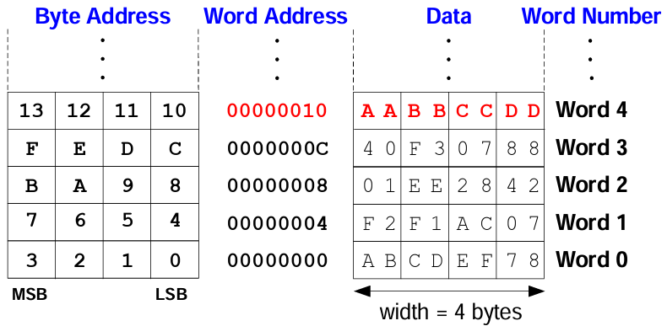
RISC V Architecture: Memory Ops (Byte)
Example: store the value held in t7 into memory address 0x10 (16)
  If t7 holds the value 0xAABBCCDD, then after the sw completes, word 4 (at address 0x10) in memory will contain that value
RISC-V assembly code:
sw t7, 0x10(zero) # write t7 into address 16

Slide 18
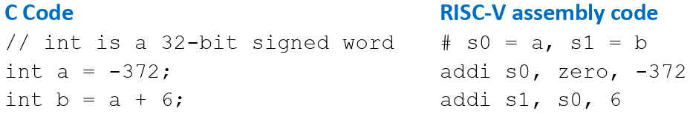
RISC V Architecture: 12-bit Constants
12-bit signed constants (immediates) using addi:
Any immediate value that requires more than 12-bits cannot use this method!

Slide 19
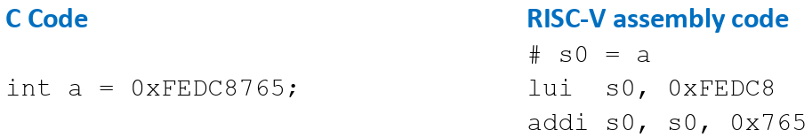
RISC V Architecture: 32-bit Constants
Use load upper immediate (lui) and addi.
lui: Puts an immediate in the upper 20-bits of destination register and 0’s in lower 12 bits.

Slide 20
RISC V Architecture: Logical Operations
and, or, xor
  and: useful for masking bits
    Masking all but the least significant byte of a value: 0xF234012F AND 0x000000FF = 0x0000002F
  or: useful for combining bit fields
    Combine 0xF2340000 with 0x000012BC: 0xF2340000 OR 0x000012BC = 0xF23412BC
  xor: useful for inverting bits:
    A XOR -1 = NOT A (remember that -1 = 0xFFFFFFFF)

Slide 21
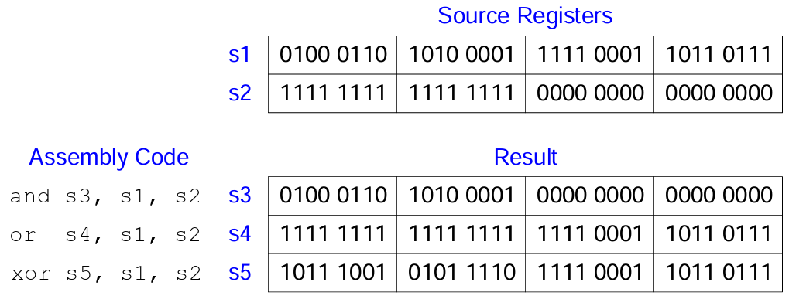
RISC V Architecture: Logical Operations

Slide 22
RISC V Architecture: Shift Instructions
Shift amount is in (lower 5 bits of) a register.
sll: shift left logical
  Example: sll t0, t1, t2 # t0 = t1 << t2
• srl: shift right logical
  Example: srl t0, t1, t2 # t0 = t1 >> t2
• sra: shift right arithmetic
  Example: sra t0, t1, t2 # t0 = t1 >>> t2

Slide 23
RISC V Architecture: Shift Instructions (IMM)
Shift amount is an immediate between 0 to 31.
• slli: shift left logical immediate
  Example: slli t0, t1, 23 # t0 = t1 << 23
• srli: shift right logical immediate
  Example: srli t0, t1, 18 # t0 = t1 >> 18
• srai: shift right arithmetic immediate
  Example: srai t0, t1, 5 # t0 = t1 >> 5

Slide 24
RISC V Architecture: Multiplication
32 × 32 multiplication → 64-bit result
mul s3, s1, s2
s3 = lower 32 bits of result
mulh s4, s1, s2
s4 = upper 32 bits of result, treats operands as signed
{s4, s3} = s1 x s2
Example:
s1 = 0x40000000 = 2³⁰; s2 = 0x80000000 = -2³¹
s1 x s2 = -2⁶¹ = 0xE0000000 00000000
s4 = 0xE0000000; s3 = 0x00000000

Slide 25
RISC V Architecture: Division
32-bit division → 32-bit quotient & remainder
div s3, s1, s2 # s3 = s1 / s2
rem s4, s1, s2 # s4 = s1 % s2
Example:
s1 = 0x00000011 = 17; s2 = 0x00000003 = 3
s1 / s2 = 5
s1 % s2 = 2
s3 = 0x00000005; s4 = 0x00000002

Slide 26
RISC V Architecture: Branches
Execute instructions out of sequence.
Types of branches:
  Conditional
    Branch if equal (beq)
    Branch if not equal (bne)
    Branch if less than (blt)
    Branch if greater than or equal (bge)
  Unconditional
    Jump (j)
    Jump register (jr)
    Jump and link (jal)
    Jump and link register (jalr)

Slide 27
RISC V Architecture: Branches (beq)
# RISC-V assembly
addi s0, zero, 4 # s0 = 0 + 4 = 4
addi s1, zero, 1 # s1 = 0 + 1 = 1
slli s1, s1, 2 # s1 = 1 << 2 = 4
beq s0, s1, target # branch is taken
addi s1, s1, 1 # not executed
sub s1, s1, s0 # not executed
target: # label
add s1, s1, s0 # s1 = 4 + 4 = 8
Labels indicate instruction location. They can’t be reserved words and must be followed by a colon (:)

Slide 28
RISC V Architecture: Branches (bne)
# RISC-V assembly
addi s0, zero, 4 # s0 = 0 + 4 = 4
addi s1, zero, 1 # s1 = 0 + 1 = 1
slli s1, s1, 2 # s1 = 1 << 2 = 4
bne s0, s1, target # branch not taken
addi s1, s1, 1 # s1 = 4 + 1 = 5
sub s1, s1, s0 # s1 = 5 – 4 = 1
target:
add s1, s1, s0 # s1 = 1 + 4 = 5

Slide 29
RISC V Architecture: Branches (j)
# RISC-V assembly
j target # jump to target
srai s1, s1, 2 # not executed
addi s1, s1, 1 # not executed
sub s1, s1, s0 # not executed
target:
add s1, s1, s0 # s1 = 1 + 4 = 5

Slide 30
RISC V Architecture: Branches (for loop)
# RISC-V assembly code
# s0 = array base address, s1 = i
# initialization code
lui s0, 0x23B8F # s0 = 0x23B8F000
ori s0, s0, 0x400 # s0 = 0x23B8F400
addi s1, zero, 0 # i = 0
addi t2, zero, 1000 # t2 = 1000
loop:
bge s1, t2, done # if not then done
slli t0, s1, 2 # t0 = i * 4 (byte offset)
add t0, t0, s0 # address of array[i]
lw t1, 0(t0) # t1 = array[i]
slli t1, t1, 3 # t1 = array[i] * 8
sw t1, 0(t0) # array[i] = array[i] * 8
addi s1, s1, 1 # i = i + 1
j loop # repeat
done:

Slide 31
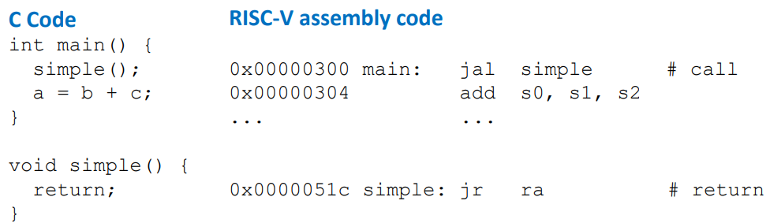
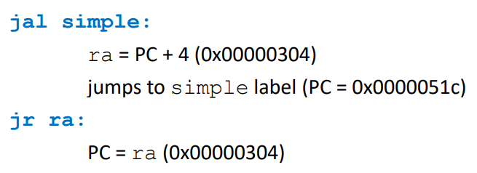
RISC V Architecture: Branches (jal)

Slide 32
RISC V Architecture: Branches (jal)
Conventions:
Call Function: jump and link (jal func)
Return from function: jump register (jr ra)
Arguments: a0 – a7
Return value: a0

Slide 33
RISC V Architecture: Branches (jal)
C Code
int main() {
int y;
...
y = diffofsums(2, 3, 4, 5); // 4 arguments
...
}
int diffofsums(int f, int g, int h, int i) {
int result;
result = (f + g) - (h + i);
return result; // return value
}

Slide 34
RISC V Architecture: Branches (jal)
RISC-V assembly code
# s7 = y main:
  . . .
  addi a0, zero, 2 # argument 0 = 2
  addi a1, zero, 3 # argument 1 = 3
  addi a2, zero, 4 # argument 2 = 4
  addi a3, zero, 5 # argument 3 = 5
  jal diffofsums # call function
  add s7, a0, zero # y = returned value
. . .
# s3 = result
diffofsums:
  add t0, a0, a1 # t0 = f + g
  add t1, a2, a3 # t1 = h + i
  sub s3, t0, t1 # result = (f + g) − (h + i)
  add a0, s3, zero # put return value in a0
  jr ra # return to caller

Slide 35
RISC V Architecture: The Stack
Memory used to temporarily save variables.
Like stack of dishes, last-infirst-out (LIFO) queue.
Expands: uses more memory when more space needed.
Contracts: Uses less memory when the space is no longer needed.

Slide 36
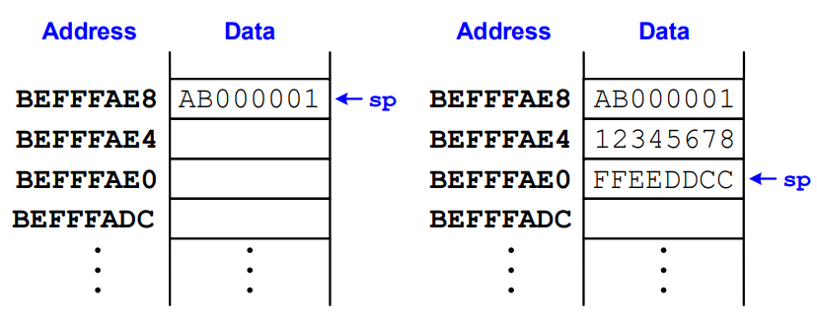
RISC V Architecture: The Stack
Grows down (from higher to lower memory addresses).
Stack pointer: sp points to top of the stack.

Slide 37
RISC V Architecture: The Stack
Called functions must have no unintended side effects.
But diffofsums overwrites 3 registers: t0, t1, s3.
# RISC-V assembly
# s3 = result
diffofsums:
add t0, a0, a1 # t0 = f + g
add t1, a2, a3 # t1 = h + i
sub s3, t0, t1 # result = (f + g) − (h + i)
add a0, s3, zero # put return value in a0
jr ra # return to caller

Slide 38
RISC V Architecture: The Stack
# s3 = result
diffofsums:
addi sp, sp, -12 # make space on stack to
# store three registers
sw s3, 8(sp) # save s3 on stack
sw t0, 4(sp) # save t0 on stack
sw t1, 0(sp) # save t1 on stack
add t0, a0, a1 # t0 = f + g
add t1, a2, a3 # t1 = h + i
sub s3, t0, t1 # result = (f + g) − (h + i)
add a0, s3, zero # put return value in a0
lw s3, 8(sp) # restore s3 from stack
lw t0, 4(sp) # restore t0 from stack
lw t1, 0(sp) # restore t1 from stack
addi sp, sp, 12 # deallocate stack space
jr ra # return to caller

Slide 39
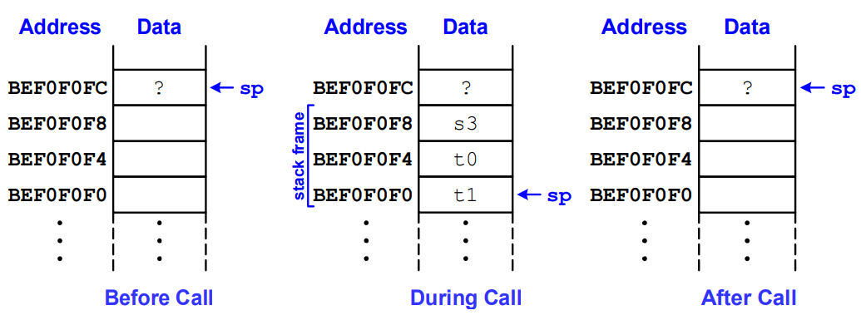
RISC V Architecture: The Stack

Slide 40
RISC V Architecture: The Stack
# s3 = result
diffofsums:
addi sp, sp, -12 # make space on stack to
# store three registers
sw s3, 8(sp) # save s3 on stack
sw t0, 4(sp) # save t0 on stack
sw t1, 0(sp) # save t1 on stack
add t0, a0, a1 # t0 = f + g
add t1, a2, a3 # t1 = h + i
sub s3, t0, t1 # result = (f + g) − (h + i)
add a0, s3, zero # put return value in a0
lw s3, 8(sp) # restore s3 from stack
lw t0, 4(sp) # restore t0 from stack
lw t1, 0(sp) # restore t1 from stack
addi sp, sp, 12 # deallocate stack space
jr ra # return to caller

Slide 41
Sources
https://www.stromasys.com/resources/breaking-down-the-features-and-architecture-of-cisc-processor/
Assigned Textbook
https://fiveable.me/introduction-computer-architecture/unit-3/risc-cisc-architectures/study-guide/w3HvrwVqcuP6lBNL
https://pages.hmc.edu/harris/class/e85/

